Slide 1
Chapter 5 Facility Location and Demand Allocation Methodologies
Supply Chain Management

Slide 2
A Framework for Global Site Location
Competitive STRATEGY
GLOBAL COMPETITION
PHASE I
Supply Chain
Strategy
INTERNAL CONSTRAINTS
Capital, growth strategy,
existing network
TARIFFS AND TAX
INCENTIVES
PRODUCTION TECHNOLOGIES
Cost, Scale/Scope impact, support
required, flexibility
REGIONAL DEMAND
Size, growth, homogeneity,
local specifications
PHASE II
Regional Facility
Configuration
COMPETITIVE
ENVIRONMENT
POLITICAL, EXCHANGE
RATE AND DEMAND RISK
PHASE III
Desirable Sites
AVAILABLE
INFRASTRUCTURE
PRODUCTION METHODS
Skill needs, response time
FACTOR COSTS
Labor, materials, site specific
PHASE IV
Location Choices
LOGISTICS COSTS
Transport, inventory, coordination
Notes:
Notes:

Slide 3
A Sequence of Decisions
Global Decision
Political, social, economic stability;
Currency exchange rates; . . . . .
Regional Decision
Climate; Customer concentrations;
Degree of unionization; . . . . .
Community Decision
Transportation system availability;
Preference of management; . . . . .
Site Decision
Site size/cost; Environmental impact;
Zoning restrictions; . . . . .

Slide 4
Global Location Factors
Government stability
Government regulations
Political and economic systems
Economic stability and growth
Exchange rates
Culture
Climate
Export import regulations, duties and tariffs
Raw material availability
Number and proximity of suppliers
Transportation and distribution system
Labor cost and education
Available technology
Commercial travel
Technical expertise
Cross-border trade regulations
Group trade agreements

Slide 5
Regional Location Factors
Labor (availability, education, cost, and unions)
Proximity of customers
Number of customers
Construction/leasing costs
Land cost
Modes and quality of transportation
Transportation costs
Community government Local business regulations
Government services (e.g., Chamber of Commerce)
Business climate
Community services
Incentive packages
Government regulations
Environmental regulations
Raw material availability
Commercial travel
Climate
Infrastructure (e.g., roads, water, sewers)
Quality of life
Taxes
Availability of sites
Financial services
Community inducements
Proximity of suppliers
Education system

Slide 6
Factors Affecting the Location Decision
Economic
Site acquisition, preparation and construction costs
Labor costs, skills and availability
Utilities costs and availability
Transportation costs
Taxes
Air, rail, highway, waterway systems
Zoning restrictions
Nearness of services/supplies needed
Environmental impact issues

Slide 7
Factors Affecting the Location Decision
Non-economic
Labor attitudes and traditions
Training and employment services
Community’s attitude
Schools and churches
Recreation and cultural attractions
Amount and type of housing available

Slide 8
Applications of Facility Location Models
Widely applied in public and private sectors:
Emergency medical services (EMS) / fire stations
Airline hubs
Blood banks
Hazardous waste disposal sites
Fast-food restaurants
Public swimming pools
Schools
Vehicle inspection stations
Bus stops
etc.

Slide 9
Facility Types and Their Dominant Locational Factors
Mining, Quarrying, and Heavy Manufacturing
Near their raw material sources
Abundant supply of utilities
Land and construction costs are inexpensive
Light Manufacturing
Availability and cost of labor
Warehousing
Proximity to transportation facilities
Incoming and outgoing transportation costs
R&D and High-Tech Manufacturing
Ability to recruit/retain scientists, engineers, etc.
Near companies with similar technology interests
Retailing and For-Profit Services
Near concentrations of target customers
Government and Health/Emergency Services
Near concentrations of constituents

Slide 10
Some Reasons the Facility Location Decision Arises
Changes in the market
Expansion
Contraction
Geographic shift
Changes in inputs
Labor skills and/or costs
Materials costs and/or availability
Utility costs
Changes in the environment
Regulations and laws
Attitude of the community
Changes in technology

Slide 11
Location Rating Factor
Identify important factors
Weight factors (0.00 - 1.00)
Subjectively score each factor (0 - 100)
Sum weighted scores

Slide 12
Location Factor Rating: Example
SCORES (0 TO 100)
LOCATION FACTOR
WEIGHT
Site 1
Site 2
Site 3
Labor pool and climate
Proximity to suppliers
Wage rates
Community environment
Proximity to customers
Shipping modes
Air service
.30
.20
.15
.15
.10
.05
.05
80
100
60
75
65
85
50
65
91
95
80
90
92
65
90
75
72
80
95
65
90
Weighted Score for “Labor pool and climate” for
Site 1 = (0.30)(80) = 24

Slide 13
Location Factor Rating
WEIGHTED SCORES
Site 1
Site 2
Site 3
24.00
20.00
9.00
11.25
6.50
4.25
2.50
77.50
19.50
18.20
14.25
12.00
9.00
4.60
3.25
80.80
27.00
15.00
10.80
12.00
9.50
3.25
4.50
82.05
Site 3 has the highest factor rating

Slide 14
Plant Location Methodology: Factor Rating Method Example
Two refineries sites (A and B) are assigned the following range of point values and respective points, where the more points the better for the site location.
Sites
A B
Major factors for site location
Pt. Range
123
150
54
24
45
4
8
5
5
156
100
63
96
50
5
4
50
20
Best Site is B
Total pts. 418 544
Notes:
9

Slide 15
The Analytic Hierarchy Process
AHP has been applied by decision makers in countless areas, including accounting, finance, marketing, energy resource planning, microcomputer selection, sociology, architecture, and political science.
1. Active community involvement and participation in decision making processes
2. Incorporation of economic and social; objective and
subjective considerations into decision making (i.e.
integrated decision making).
3. Provides a theoretical basis for consistent decision making
Notes:
Gives a theoretical grounding for consistent decision making

Slide 16
The Analytic Hierarchy Process
- a goal or the focus of a problem
- a finite number of alternative plans or options;
- a set of criteria by which alternatives are to be judged; and
- a method of ranking the alternatives based on how well they satisfy the objective
Proposed Process
Identify
Goal
Develop
Criteria
Weight
Criteria
Rank
Alternatives
Identify
Alternatives

Slide 17
The Analytic Hierarchy Process
General Structure of a Problem

Slide 18
Obtaining Weights for Each Objective
Suppose there are n criteria.
We begin by writing down an n x n matrix (known as the pairwise comparison matrix) A.
The entry in row i and column j of A indicates how much more important criteria i is than criteria j.
When comparing criterion 1 to criterion 2, ...
‘Which is more important?’
‘Which has a greater impact?’
‘Which is more likely to happen?’ or
‘Which is more preferred?’
… The nature of the question depends on the desired outcome and level being compared

Slide 19
Pairwise Comparisons of
Criteria for Car Purchase
Judgement Matrix
Price MPG Comfort Style
Price
MPG
Comfort
Style
1.000
#
#
#
1.000
1/#
#
#
1.000
1/#
1/#
#
1.000
1/#
1/#
1/#

Slide 20
Scale of Relative Importance
Use this scale to articulate preferences
Numerical Value
1
3
5
7
9
2,4,6,8
Reciprocals
Definition
Equally important or preferred
Slightly more important or preferred
Strongly more important or preferred
Very strongly more important or preferred
Extremely more important or preferred
Intermediate values to reflect compromise
Used when the second criterion is dominant

Slide 21
The Analytic Hierarchy Process

Slide 22
The Analytic Hierarchy Process

Slide 23
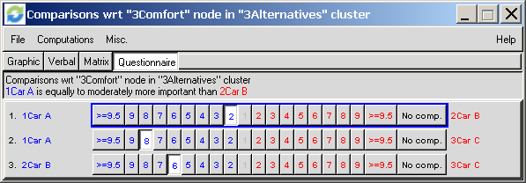
Judgment Matrix Evaluation
Screenshots are of “Super Decisions”
www.superdecisions.com

Slide 24
Evaluating Comfort Criterion

Slide 25
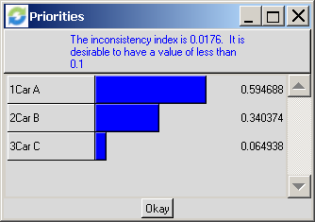
Evaluating Comfort Criterion

Slide 26
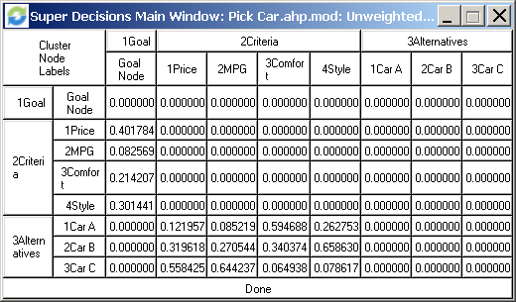
Pairwise Comparisons

Slide 27
Car Ranking

Slide 28
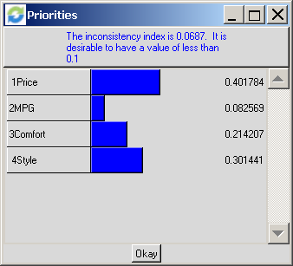
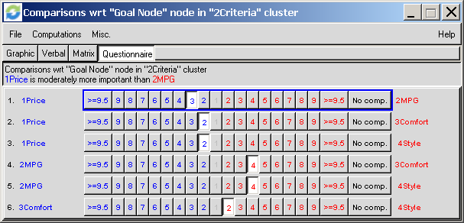
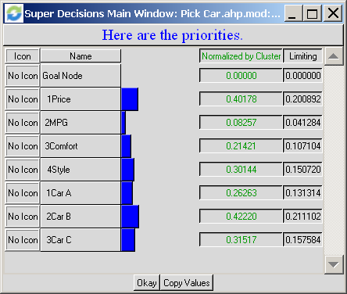
“Super Decision” Output

Slide 29
Checking for Consistency
We can now use the following four-step procedure to check for consistency of the decision maker’s comparison. (w denotes the estimate of the decision maker’s priorities)
Step 1: Compute Aw^{T}.
Step 2: Compute
Step 3: Computer the consistency index(CI) as follows
Step 4: Compare CI to the random index (RI) for the appropriate value of n.

Slide 30
Checking for Consistency
Random Index (RI)
sample of 500 randomly generated matrices for each n
For a perfectly consistent decision maker, the ith entry in Aw^{T}=n (ith entry of w^{T}).
If CI / RI < 0.1 , the decision maker’s comparisons are probably consistent enough to give useful estimates of the priorities for the Judgment Matrix , A , of dimension n
n | 1 | 2 | 3 | 4 | 5 | 6 | 7 | 8 | 9 | 10
RI | 0 | 0 | .58 | .9 | 1.12 | 1.24 | 1.32 | 1.41 | 1.45 | 1.49

Slide 31
Consistency of Car Criteria A-matrix
CI / RI < .1, car criteria judgment matrix is consistent

Slide 32
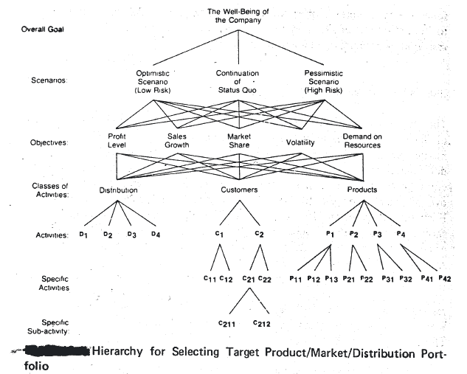
Multilevel AHP Hierarchy

Slide 33
Location Factor Rating: Example
SCORES (0 TO 100)
LOCATION FACTOR
WEIGHT
Site 1
Site 2
Site 3
Labor pool and climate
Proximity to suppliers
Wage rates
Community environment
Proximity to customers
Shipping modes
Air service
.30
.20
.15
.15
.10
.05
.05
80
100
60
75
65
85
50
65
91
95
80
90
92
65
90
75
72
80
95
65
90
Weighted Score for “Labor pool and climate” for
Site 1 = (0.30)(80) = 24

Slide 34
Location Factor Rating: Example
AHP Hierarchy
Site Selection
Labor Pool
and
Climate
Proximity
to
Suppliers
Wage
Rates
Community
Environment
Proximity
to
Customers
Shipping
Modes
Air
Service
Site 1
Site 2
Site 3
Location /
Allocation
Analysis

Slide 35
Steps in the Capacity Planning Process
Estimate the capacity of the present facilities.
Forecast the long-range future capacity needs.
Identify and analyze sources of capacity to meet these needs.
Select from among the alternative sources of capacity.

Slide 36
Definitions of Capacity
In general, production capacity is the maximum production rate of an organization (or maximum conversion rate of a production system) in any given period.
Sustainable practical capacity is the greatest level of output that a plant can maintain:
within the framework of a realistic work schedule
taking account of normal downtime
assuming sufficient availability of inputs to operate the machinery and equipment in place

Slide 37
Measures of Capacity
Output rate capacity – Suitable for a single product or a few homogeneous products
Design capacity - The maximum capacity that can be achieved under ideal conditions
Effective capacity utilization - The percent of design capacity actually achieved
Aggregate capacity – Suitable when a common unit of output is used
Rated capacity – Maximum usable capacity of a particular facility
Input rate capacity – Suitable for service operations
Percentage utilization of capacity - Relates output measures to inputs available

Slide 38
Capacity Cushion
A capacity cushion is an additional amount of capacity added onto the expected demand to allow for:
greater than expected demand
demand during peak demand seasons
lower production costs
product and volume flexibility
improved quality of products and services

Slide 39
Forecasting Capacity Demand
Consider the life of the input (e.g. facility is 10-30 yr)
Understand product life cycle as it impacts capacity
Anticipate technological developments
Anticipate competitors’ actions
Forecast the firm’s demand
Forecast sales within each individual product line
Calculate equipment and labor requirements to meet the forecasts
Project equipment and labor availability over the planning horizon

Slide 40
Economies of Scale
Best operating level - least average unit cost
Economies of scale - average cost per unit decreases as the volume increases
Diseconomies of scale - average cost per unit increases as the volume increases
Other considerations
Subcontractor and supplier networks
Focused production
Economies of scope
Average Unit
Cost of Output ($)
Economies
of Scale
Diseconomies
of Scale
Best Operating Level
Annual Volume (units)

Slide 41
Economies and Diseconomies of Scale
Average Unit
Cost of Output ($)
Optimum Plant Size
100-unit
plant
200-unit
plant
400-unit
plant
300-unit
plant
Annual Volume (units)

Slide 42
Locational Breakeven Analysis

Slide 43
Network Optimization Models
Allocating demand to production facilities
Locating facilities and allocating capacity
Key Costs:
Fixed facility cost
Transportation cost
Production cost
Inventory cost
Coordination cost
Which plants to establish? How to configure the network?
Notes:
Notes:

Slide 44
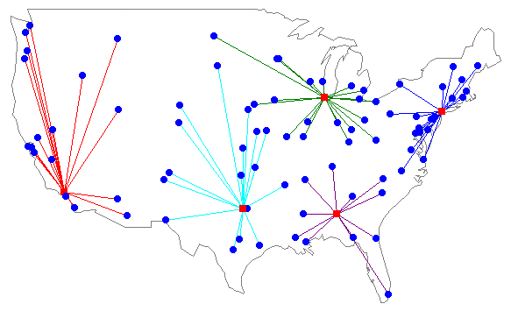
Plant Location with Multiple Sourcing
sites/clients
facilities/servers

Slide 45
Plant Location Problem
This is the warehouse location problem with a single warehouse that can be located anywhere in the plane. Distances are “Euclidean.”
y
Loc. Dem.
A: (8,2) 19
B: (3,10) 7
C: (8,15) 2
D: (14,13) 5
P: ?
C
(2)
16
14
D(5)
12
10
B
(7)
8
P ?
6
4
2
A
(19)
0
x
0
2
4
6
8
10
12
14
16

Slide 46
Here are the objective values for 55 different locations.
d(P,A) = …
minimize 19 d(P,A) + … + 5 d(P,D) subject to: P is unconstrained
d(P,D) =

Slide 47
Network Design Models
Maximize supply chain profitability
More often: minimize cost
While providing customers with the appropriate responsiveness
Typical decisions made by network design models:
Locations of facilities
Capacities, capabilities of facilities
Assignment of supply and demand nodes to facilities
Many of these are also known as facility location models
We’ll formulate as mixed-integer programming (MIP) problems

Slide 48
Capacitated Plant Location Problem (CPLP)
Also known as Capacitated Facility Location Problem (CFLP)
Choose:
Locations of plants (warehouses, etc.)
Flows from plants to customers
Minimize:
Fixed location cost + transportation cost
Subject to:
Satisfy all demand
Respect capacity constraints at plants
Can be used for Phase II or IV

Slide 49
Warehouse location problem
n warehouses
cost f_{i} of opening warehouse i
m customers
customer j has a “demand” of d_{ij}
unit shipping cost c_{ij} of serving customer i via warehouse j.
Variables:
let y_{i} = 1 if warehouse i is opened
Let x_{ij} = amount of demand for customer j satisfied via warehouse i.

Slide 50
Plant Location with Multiple Sourcing
Decision Variables
y_{i} = 1 if plant is located at site i, 0 otherwise
x_{ij} = Quantity shipped from plant site i to customer j
Parameters
K_{i} = Potential capacity of plant i
D_{j} = Annual demand of customer j
f_{i} = Annualized fixed cost to keep plant i open
c_{ij} = Unit cost to produce and ship from plant i to customer j
k = Upper bound on the number of plants to open
Notes:
Notes:

Slide 51
Regional Facility Configuration

Slide 52
Regional Solution

Slide 53
Revealing Excel Formulae

Slide 54
CPLP: Variants
No capacity constraints
Uncapacitated plant location problem (UPLP)
Different time bucket (months, decades, …)
Plant-specific raw material costs
Make closure decisions
Economies of scale in inventory, production, shipping costs
Multiple capacity types
Merging two supply chains

Slide 55
A Framework for Global Site Location
Competitive STRATEGY
GLOBAL COMPETITION
PHASE I
Supply Chain
Strategy
INTERNAL CONSTRAINTS
Capital, growth strategy,
existing network
TARIFFS AND TAX
INCENTIVES
PRODUCTION TECHNOLOGIES
Cost, Scale/Scope impact, support
required, flexibility
REGIONAL DEMAND
Size, growth, homogeneity,
local specifications
PHASE II
Regional Facility
Configuration
COMPETITIVE
ENVIRONMENT
POLITICAL, EXCHANGE
RATE AND DEMAND RISK
PHASE III
Desirable Sites
AVAILABLE
INFRASTRUCTURE
PRODUCTION METHODS
Skill needs, response time
FACTOR COSTS
Labor, materials, site specific
PHASE IV
Location Choices
LOGISTICS COSTS
Transport, inventory, coordination
Notes:
Notes:

Slide 56
Gravity Location Models
Locate a single facility anywhere
To minimize inbound and outbound transportation costs
No pre-selected potential locations
Useful for choosing potential locations within a region for use in CPLP
Phase III

Slide 57
The Gravity Problem
The objective is to minimize the weighted sum of the squared Euclidean distances of the new facility to the current facilities. It is an uncommon problem but has a simple solution.
The optimal solution is that both the x and y coordinates of the new facility are the ratio of the weighted x and y coordinates of the existing facilities divided by the sum of the weights.

Slide 58
Gravity Methods for Location
The Min Travel Cost Solution
x,y: Warehouse Coordinates
x_{n}, y_{n} : Coordinates of delivery location n
d_{n} : Distance to delivery location n
F_{n}: cost of shipping one unit for one mile between the facility and either market or supply source n
D_{n}: quantity to be shipped between facility and market or supply source n
Min
Notes:
Notes:

Slide 59
Center-of-Gravity Approximation
Min
The coordinates of the depot uses the square of the distance in the objective function
The easy closed-form solution may be used as a starting point for a recursive solution to the straight-line Gravity Model.

Slide 60
Grid-Map Coordinates
y
n
n
∑
x_{i}F_{i}
∑
y_{i}F_{i}
2 (x₂, y₂), F₂
i = 1
i = 1
y₂
x =
n
y =
n
∑
F_{i}
∑
F_{i}
1 (x₁, y₁), F₁
i = 1
i = 1
y₁
where,
x, y = coordinates of new facility at center of gravity
x_{i}, y_{i} = coordinates of existing facility i
F_{i} = annual cost / mile for shipments to facility i
3 (x₃, y₃), F₃
y₃
x₁
x₂
x₃
x

Slide 61
Center-of-Gravity Approximation: Example
Suppliers
A B C D
X 200 100 250 500
Y 200 500 600 300
FD 75 105 135 60
n
∑
x_{i}F_{i}D_{i}
i = 1
(200)(75) + (100)(105) + (250)(135) + (500)(60)
75 + 105 + 135 + 60
x = = = 238
n
∑
F_{i}D_{i}
i = 1
n
∑
y_{i}F_{i}D_{i}
i = 1
(200)(75) + (500)(105) + (600)(135) + (300)(60)
75 + 105 + 135 + 60
y = = = 444
n
∑
F_{i}D_{i}
i = 1

Slide 62
Arbitrary Gravity Solution

Slide 63
Optimal Gravity Solution

Slide 64
Revealing Excel Formulae

Slide 65
Facility Location Distance Metrics
Goal is to find the optimal location of one or more new facilities. Optimality depends on the objective used. In many systems, the objective is to minimize some measure of distance. Two common distance measures:
Straight line distance (Euclidean distance). The distance between (a,b) and (x,y) is given by the formula:
Rectilinear Distance (as might be measured following roads on city streets).

Slide 66
A Framework for Global Site Location
Competitive STRATEGY
GLOBAL COMPETITION
PHASE I
Supply Chain
Strategy
INTERNAL CONSTRAINTS
Capital, growth strategy,
existing network
TARIFFS AND TAX
INCENTIVES
PRODUCTION TECHNOLOGIES
Cost, Scale/Scope impact, support
required, flexibility
REGIONAL DEMAND
Size, growth, homogeneity,
local specifications
PHASE II
Regional Facility
Configuration
COMPETITIVE
ENVIRONMENT
POLITICAL, EXCHANGE
RATE AND DEMAND RISK
PHASE III
Desirable Sites
AVAILABLE
INFRASTRUCTURE
PRODUCTION METHODS
Skill needs, response time
FACTOR COSTS
Labor, materials, site specific
PHASE IV
Location Choices
LOGISTICS COSTS
Transport, inventory, coordination
Notes:
Notes:

Slide 67
Demand Allocation Model
Which market is served by which plant?
Which supply sources are used by a plant?
Decision revisited more frequently than site location.
x_{ij} = Quantity shipped from plant site i to customer j

Slide 68
Solution Requirements
If time is not an issue and there is only one commodity, this is the transportation problem.
Each supplier has a capacity
Each plant has a demand,
which comes from the MRP
This is a small transportation
problem (LP)
Without capacities, finds
best suppliers by transport
costs.
Supplier 1
Sub-
Assembly
Supplier 2
Sub-
Assembly
Supplier 3

Slide 69
Two-Stage Transportation Model
Consider the following notation:
S_{i} capacity of supply source i, i = 1, 2, ..., p
P_{j} capacity of plant j, j = 1, 2, ..., q
D_{k} demand at customer k, k = 1, 2, ..., r
c_{ij} cost of transporting one unit from supply source i to plant j
d_{jk} cost of production and transporting one unit from plant j to customer k
The LP model is:

Slide 70
Two-Stage Transportation Model
p
q
q
r
Minimize Σ Σ c_{ij}x_{ij} + Σ Σ d_{jk}y_{jk}
i=1
j=1
j=1
k=1
Subject to:
q
q
Σ x_{ij} ≤ S_{i}, i = 1, 2, ..., p
Σ y_{jk} ≥ D_{k}, k = 1, 2, ..., r
j=1
j=1
p
p
r
Σ x_{ij} ≤ P_{j}, j = 1, 2, ..., q
Σ x_{ij} = Σ y_{jk}, j = 1, 2, ..., q
i=1
i=1
k=1
x_{ij}, y_{jk}, ≥ 0 i = 1, 2, ..., p, j = 1, 2, ..., q, k = 1, 2, ..., r

Slide 71
Four cases arise:
(i) Supply source capacity is unlimited and total plant capacity is more than total demand;
(ii) Supply source capacity is unlimited and total demand exceeds total plant capacity;
(iii) Plant capacity is unlimited and total supply source capacity exceeds total demand; and
(iv) Plant capacity is unlimited and total demand exceeds total supply source capacity.

Slide 72
Example: 2-Stage Distribution Problem
RIFIN Company has recently developed a new method of manufacturing a type of chemical. It involves refining a certain raw material which can be obtained from
four overseas suppliers A, B, C, D who have access
to the four ports at Vancouver, Boston, Miami, and San Francisco, respectively.
RIFIN wants to determine the work load of plants at which the chemical will be refined.
The chemical, once refined, will be transported via trucks to five outlets located at Dallas, Phoenix, Portland, Montreal and Orlando.

Slide 73
Example: 2-Stage Distribution Problem
RIFIN’s refineries are located at Denver, Atlanta and Pittsburgh.
Assume that one unit of raw material is required to make one unit of chemical.
The amount of raw material from each potential refinery as well as the cost of trucking the chemical to outlets are also provided below.
Determine the work load of RIFIN’s refining plants and distribution pattern for the raw material and processed chemical.

Slide 74
Example: 2-Stage Distribution Problem
Raw Material Source Supply Outlet Demand
A 1000 Dallas 900
B 800 Phoenix 800
C 800 Portland 600
D 700 Montreal 500
Orlando 500
For this problem, the supply sources are no less than total demand and total plant capacities are assumed to have unlimited capacities (case (iii)).

Slide 75
Example: 2-Stage Distribution Problem
Raw Material Transportation Cost
TO Denver Atlanta Pittsburgh
FROM
Vancouver 4 13 9
Boston 8 8 5
Miami 12 2 9
San Francisco 11 11 12
Chemical Trucking Cost
TO Dallas Phoenix Portland Montreal Orlando
FROM
Den. 28 26 12 30 30
Atla. 10 22 23 29 8
Pitts. 18 21 23 18 21

Slide 76
Pictorial representation of RIFIN Example
Da
V
D
Ph
B
A
Po
M
Mo
P
SF
Orl
The transportation problem may be solved to yield the solution indicated in the following figure.

Slide 77
Example: 2-Stage Distribution Solution
Da
V
1000
900
D
400
Ph
B
600
800
Po
A
800
400
M
500
Mo
600
P
500
SF
100
Orl

Slide 78
Solution Requirements
If time is an issue (dynamic) and commodities differ greatly, more difficult
Approach: Multi-Commodity Network
Origin-Destination pairs become the commodities
Difficult to get integer solutions when network is capacitated
Solutions approaches vary: decomposition approaches are common

Slide 79
HighOptic Demand Allocation Problem

Slide 80
HighOptic Demand Allocation Problem Solution

Slide 81
TelecomOne Demand Allocation Problem Solution

Slide 82
Merged TelecomOptic Demand Allocation Solution
FIGURE 5-12

Slide 83
Network Optimization Models finer “granularity”
In smaller regions, with more detailed information…
Allocating demand to production facilities
Locating facilities and allocating capacity
Fixed facility cost
Transportation cost
Production cost
Inventory cost
Coordination cost
Notes:
Notes:

Slide 84
Plant Location with Multiple Sourcing
Decision Variables
y_{i} = 1 if plant is located at site i, 0 otherwise
x_{ij} = Quantity shipped from plant site i to customer j
Parameters
K_{i} = Potential capacity of plant i
D_{j} = Annual demand of customer j
f_{i} = Annualized fixed cost to keep plant i open
c_{ij} = Unit cost to produce and ship from plant i to customer j
k = Upper bound on the number of plants to open
Notes:
Notes:

Slide 85
TelecomOptic Capacitated Plant Location Solution

Slide 86
Uncapacitated Facility Location with Single Sourcing
Given potential facility locations, n customers to be served
c_{j} = annualized cost to build facility j
h_{ij} = annual cost to meet all of customer i’s demand from facility j
Notes:
No constraint on # customers a facility can service

Slide 87
Formulation is really important in practice
Unconstrained facility location “supply switch”:
Could sum constraints over all customers i to get:
Recall n is the number of customers.
Still requires a facility is built before use (IPs are equivalent at optimality)
But, for 40 customers, 40 facilities, random costs
First formulation solves in 2 seconds
Second formulation solves in 53,121 seconds (14.75 hours)

Slide 88
Capacitated Facility Location with Single Sourcing

Slide 89
Single Source Solution

Slide 90
Depot Location Objectives
Minimize average distance between depots and customers
Transportation/distribution applications
“The Median Problem”
Solution lies at a node (Hakimi 1964)
Minimize distance of farthest user
Fire, ambulance or police station applications
“Absolute Center Problem”
Solution may lie on an arc

Slide 91
1-Median Problem Heuristic Discrete Site Alternatives
1. Calculate shortest distances d_{ij} between nodes.
2. Multiply j^{th} column of distance matrix by the number of service demands D_{j}.
3. Divide matrix from (2) by the sum of all D_{j} values for new relative values. Add up elements of each row = average distance covered by users when depot is at node i.
4. Select the least value depot.

Slide 92
The p-Median Problem
1. Find location of first depot as before among the N nodes.
2. Examine all possible locations (N-selection from (1)) and select best combination according to objective function (min distance).
3. Systematically replace one node from set in (2) and check for improvements with objective function. Improve? Make switch. Else nothing.
4. Stop when desired number of depots placed.
Software exists to solve problems with 25-50 facilities with 200+ nodes

Slide 93
The p-Median Problem
Obviously a much tougher problem
To ensure that you have the optimal solution, you will have to try all combinations
This can become extremely tedious
D_{j} if demand weighted average used

Slide 94
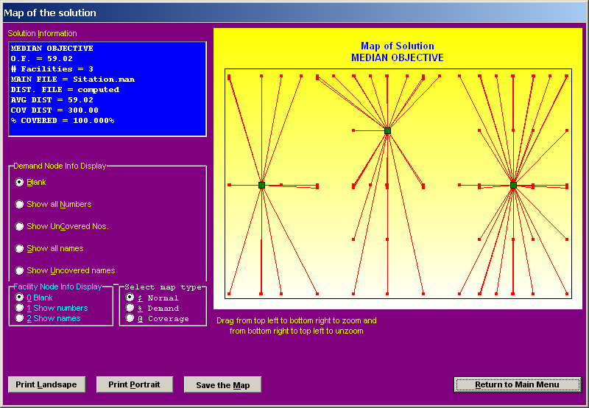
Daskin p-Median Solution to an Example

Slide 95
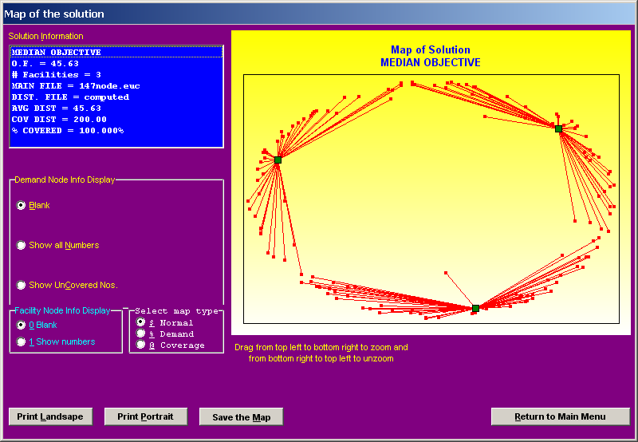
Daskin p-Median Problem

Slide 96
Multiple-Facility Problems with Euclidean Distances
Objective for the Euclidean distance problem.
cost / unit flow / unit distance between i and j
level of flow between i and j

Slide 97
Rectilinear Solution
Problem: Given a network of nodes on a grid with demands and locations of nodes, determine the optimal location of a depot(s).
Location on the grid is at point (x,y), where x is an x-coordinate currently occupied by a facility and y is a y-coordinate occupied by a facility (not necessarily the same facility).
Solution: The optimal point is a medium sum location -- no more than half of the total weight lies to the left or right (above or below) the optimal point.

Slide 98
Example : Locate depot assuming rectilinear movement.
50
80
90
50
60

Slide 99
Solution
x-coordinate:
y-coordinate:
Half Weight = 330/2 = 165
Median
Median
Locate facility at (300,300).

Slide 100
The Rectilinear p-Median Problem

Slide 101
The Rectilinear p-Median Problem
A similar definition of y⁺_{ij}, y⁻_{ij} , xa⁺_{ij}, xa⁻_{ij} yb⁺_{ij} , and yb⁻_{ij} yields
|y_{i} - y_{j}| = y⁺_{ij} + y⁻_{ij}
y_{i} - y_{j} = y⁺_{ij} - y⁻_{ij}
|x_{i} - a_{j}| = xa⁺_{ij} + xa⁻_{ij}
x_{i} - a_{j} = xa⁺_{ij} - xa⁻_{ij}
|y_{i} - b_{j}| = yb⁺_{ij} + yb⁻_{ij}
y_{i} - b_{j} = yb⁺_{ij} - yb⁻_{ij}

Slide 102
Thus, the transformed linear model is:
Subject to:
x_{i} - x_{j} = x⁺_{ij} - x⁻_{ij}
y_{i} - y_{j} = y⁺_{ij} - y⁻_{ij}
x_{i} - a_{j} = xa⁺_{ij} - xa⁻_{ij}
y_{i} - b_{j} = yb⁺_{ij} - yb⁻_{ij}
x⁺_{ij}, x⁻_{ij}, y⁺_{ij} , y⁻_{ij} > 0, i, j = 1, 2, ..., n
xa⁺_{ij}, xa⁻_{ij}, yb⁺_{ij} , yb⁻_{ij} > 0, i = 1, 2, ..., n, j =1,2,...,m
x_{i}, y_{i} unrestricted in sign, i = 1,2,...,n

Slide 103
The Rectilinear p-Median Problem
x_{ij}⁺ or x_{ij}⁻, but not both, can be greater than 0.
Similarly, only one of (i) y_{ij}⁺, y_{ij}⁻, (ii) xa_{ij}⁺, xa_{ij}⁻, (iii) yb_{ij}⁺, yb_{ij}⁻, may be greater than 0.
The model can be simplified by noting that:
x_{i} can be substituted as a_{i} + xa_{ij}⁺ - xa_{ij}⁻
y_{i} may also be substituted similarly, resulting in a model with 2n fewer constraints and variables than model 1.

Slide 104
Rectilinear p-Median Example
Tires and Brakes, Inc., is an automobile service company specializing in tire and brake replacement.
It has four service centers in a metropolitan area and a warehouse that supplies tires, brakes and other components to the service centers.
The company manager has determined that he needs to add two more warehouses so as to improve component delivery service.
He wants to ensure that the location of the two new warehouses is such that the cost of delivery components from the new warehouse to the existing facilities (four service centers and existing warehouse) as well as between the new warehouses is minimal.
The four service centers and warehouse are located at the following coordinate locations - (8, 2), (8, 10), (10, 20), (16, 30), and (35, 20).
It is anticipated that there will be one trip per day between the new warehouses.
a₁
b₄
c₁₂ = c₂₁ = 1

Slide 105
Rectilinear p-Median Example
In addition, the number of trips between the new warehouses and four service centers as well as the existing warehouse is provided below.
SC₁ SC₂ SC₃ SC₄ SC₅
d_{ij} matrix
W₁ 7 7 5 4 2
W₂ 3 2 4 5 2
Develop a model similar to the transformed Model to minimize distribution cost and solve.

Slide 106
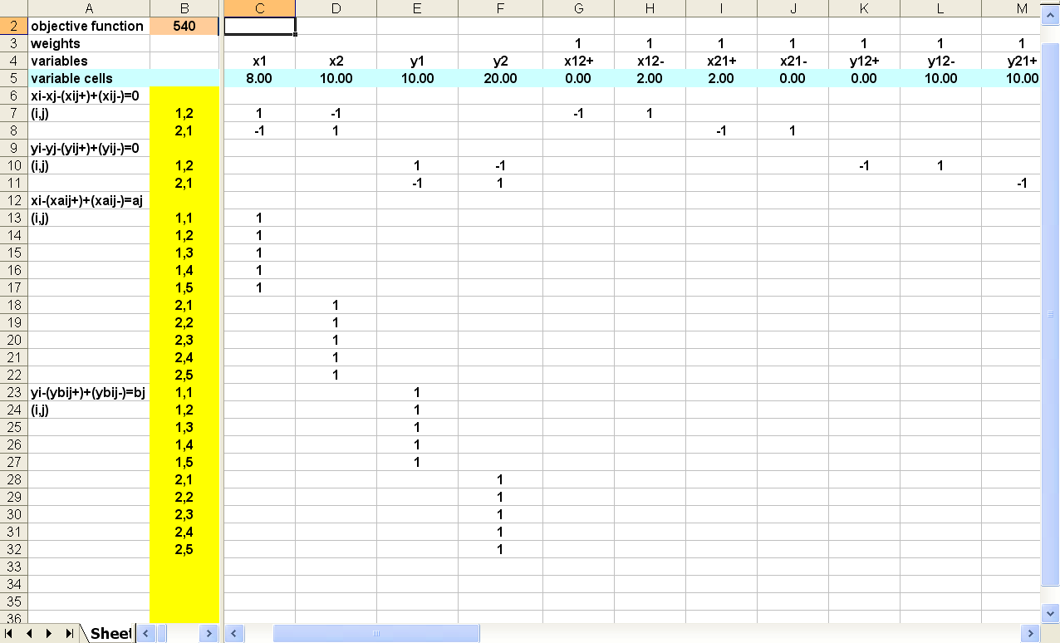
Rectilinear p-Median Solution
(x_{i} - x_{j}) = x⁺_{ij} - x⁻_{ij}
y_{i} - y_{j} = y⁺_{ij} - y⁻_{ij}
x_{i} - a_{j} = xa⁺_{ij} - xa⁻_{ij}
y_{i} - b_{j} = yb⁺_{ij} - yb⁻_{ij}

Slide 107
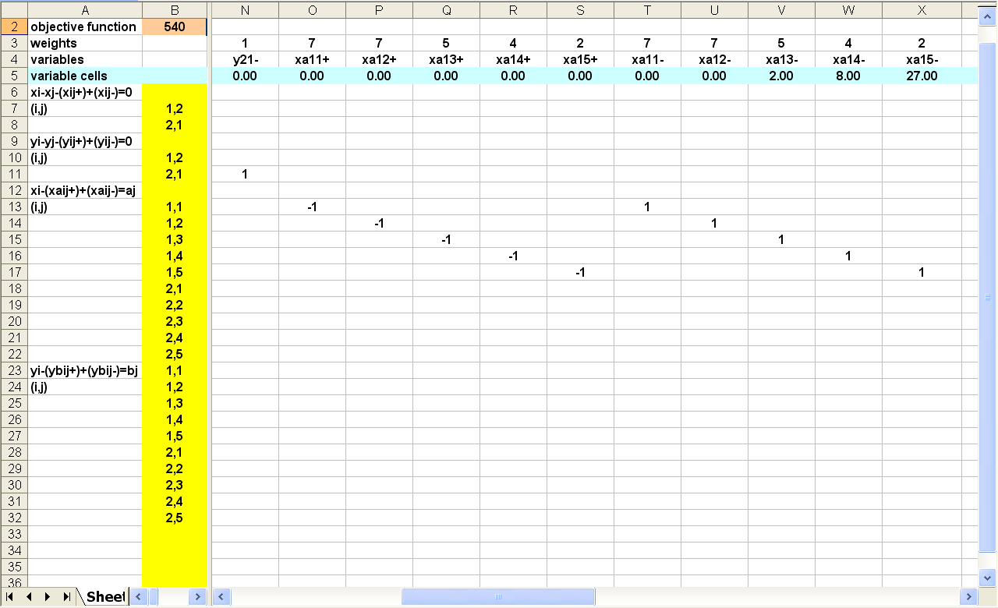
Rectilinear p-Median Solution

Slide 108
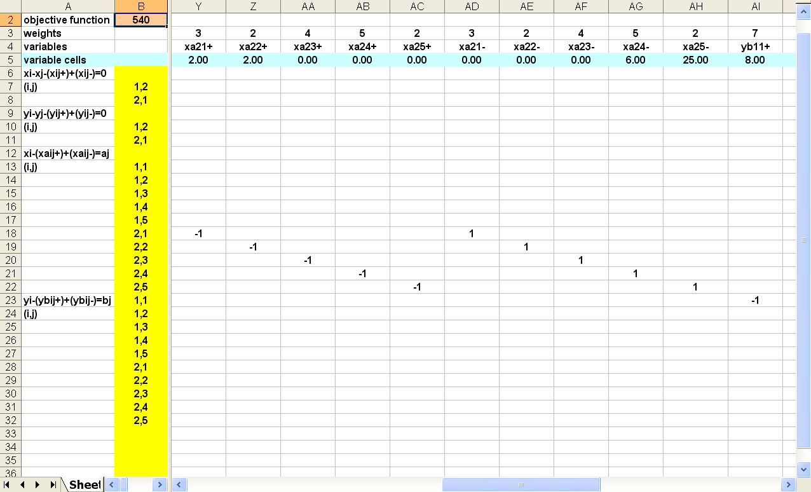
Rectilinear p-Median Solution

Slide 109
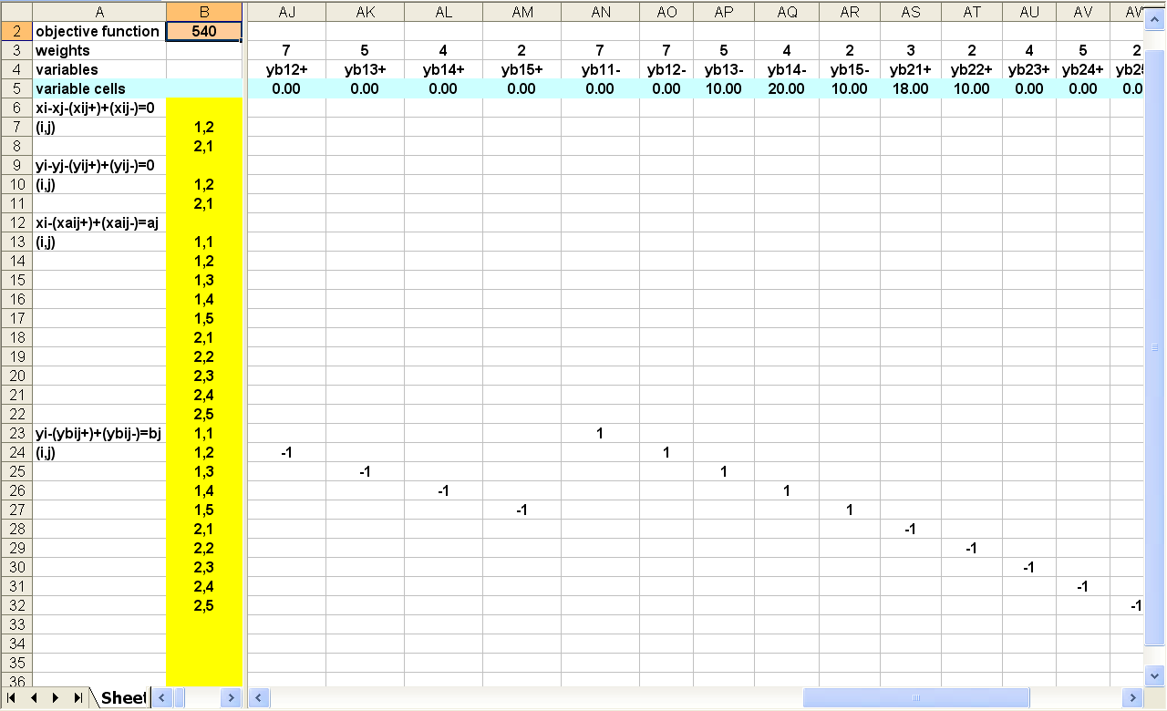
Rectilinear p-Median Solution

Slide 110
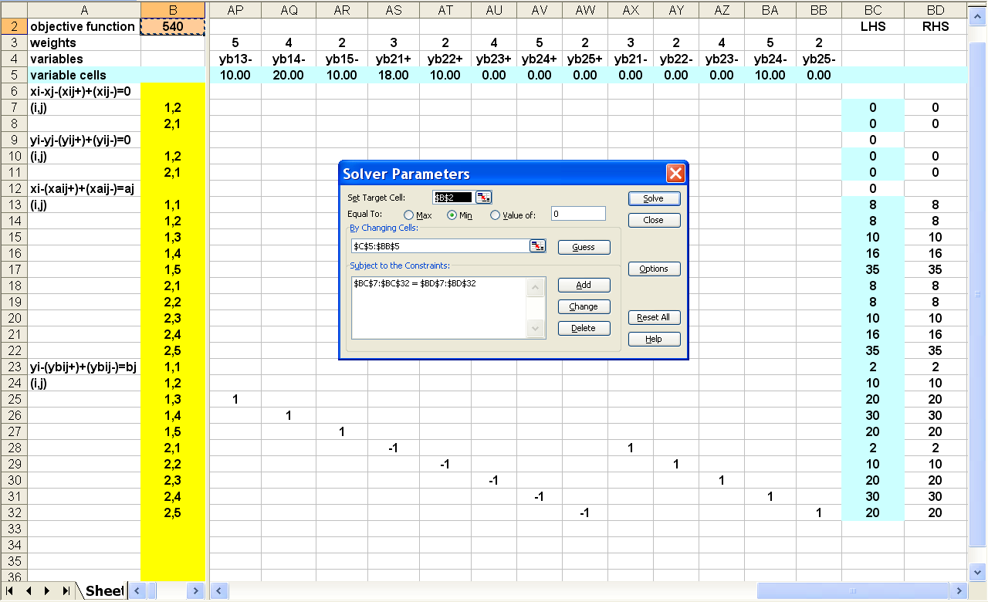
Rectilinear p-Median Solution

Slide 111
p-center problem
1-center
Minimize the maximum distance to the facility

Slide 112
p-center problem
3-center
Minimize maximum distance to the closest facility

Slide 113
The p-center approximation problem
site locations correspond to chosen demand locations
theoretically, that does not have to be the case
linear MIP easier to solve

Slide 114
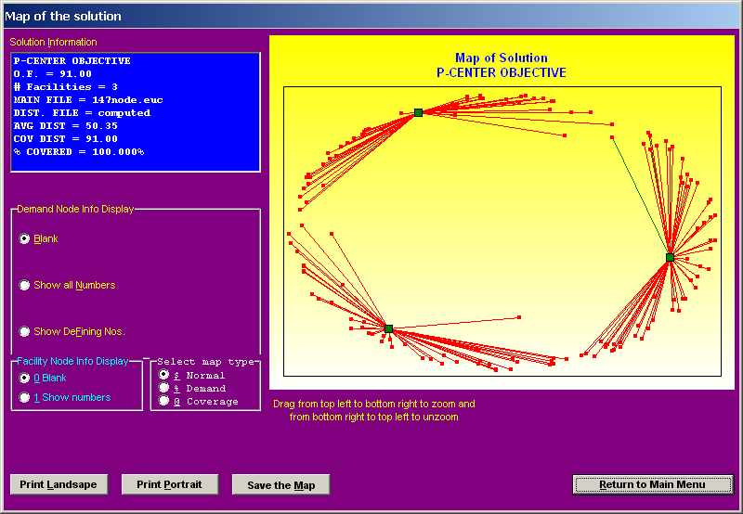
Daskin p-center problem

Slide 115
Set Covering Model
Define:
c_{j} cost of locating facility at site j
a_{ij} =
x_{j} =
{
1 if facility located at site j can cover customer i
0 Otherwise
{
1 if facility is located at site j
0 Otherwise
The set covering problem is to:

Slide 116
Set Covering Model
The set covering problem is to:
n
Minimize Σc_{j}x_{j}
j=1
Subject to:
n
Σ a_{ij}x_{j} ≥ 1, i = 1, 2, ..., m
j=1
x_{j} = 0 or 1, j = 1, 2, ..., m

Slide 117
Greedy Heuristic for Set Covering Problem
Step 1: If c_{j} = 0, for any j = 1, 2, ..., n
… set x_{j} = 1 and
… remove all constraints in which x_{j} appears with a coefficient of “+1”.
Step 2: If c_{j} > 0, for any j = 1, 2, ..., n
and x_{j} does not appear with a “+1” coefficient in any of the remaining constraints
… set x_{j} = 0.

Slide 118
Greedy Heuristic for Set Covering Problem
Step 3: For each of the remaining variables
… determine c_{j}/d_{j}, where d_{j} is the number of constraints in which x_{j} appears with a “+1” coefficient
… select the variable k for which c_{k}/d_{k} is minimum
… set x_{k} = 1 and remove all constraints in which x_{k} appears with a “+1” coefficient
… examine the resulting model.
Step 4 If there are no more constraints
… set all the remaining variables to 0 and stop
… otherwise go to step 2.

Slide 119
Greedy Heuristic for Set Covering Example
A rural county administration wants to locate several medical emergency response units so that it can respond to calls within the county within eight minutes of the call.
The county is divided into seven population zones.
The distance between the centers of each pair of zones is known and is given in the matrix below.
1 2 3 4 5 6 7
1 0 4 12 6 15 10 8
2 8 0 15 60 7 2 3
3 50 13 0 8 6 5 9
4 9 11 8 0 9 10 3
5 50 8 4 10 0 2 27
6 30 5 7 9 3 0 27
7 8 5 9 7 25 27 0
[d_{ij}] =

Slide 120
Greedy Heuristic for Set Covering Example
The response units can be located in the center of population zones 1 through 7 at a cost (in hundreds of thousands of dollars) of 100, 80, 120 110, 90, 90, and 110 respectively.
Assuming the average travel speed during an emergency to be 60 miles per hour, formulate an appropriate set covering model to determine where the units are to be located and how the population zones are to be covered and solve the model using the greedy heuristic.
Defining
{
1 if zone i’s center can be reached from center of zone j within 8 minutes
a_{ij} =
0 otherwise
and noting that d_{ij} > 8, d_{ij} ≤ 8 would yield a_{ij} values of 0, 1, respectively the following [a_{ij}] matrix can be set up.

Slide 121
Solution:
1 2 3 4 5 6 7
1 1 1 0 1 0 0 1
2 1 1 0 0 1 1 1
3 0 0 1 1 1 1 0
4 0 0 1 1 0 0 1
5 0 1 1 0 1 1 0
6 0 1 1 0 1 1 0
7 1 1 0 1 0 0 1
[a_{ij}] =
The corresponding set covering model is:

Slide 122
Solution:
Minimize Subject to:
100x₁+80x₂+120x₃+110x₄+90x₅+90x₆+110x₇
x₁ + x₂ + x₄ + x₇
x₁ + x₂ + x₅ + x₆ + x₇
x₃ + x₄ + x₅ + x₆
x₃ + x₄ + x₇
x₂ + x₃ + x₅ + x₆
x₂ + x₃ + x₅ + x₆
x₁ + x₂ + x₄ + x₇
x₁ , x₂ , x₃ , x₄ , x₅ , x₆ , x₇
≥ 1
≥ 1
≥ 1
≥ 1
≥ 1
≥ 1
≥ 1
= 0 or 1

Slide 123
Greedy Heuristic
Step 1: Since each c_{j} > 0, j = 1, 2, ..., 7, go to step 2.
Step 2: Since x_{j} appears in each constraint with a “+1” coefficient, go to step 3.
Step 3:
c₁
100
c₅
90
=
=
33.3
=
=
22.5
d₁
3
d₅
4
c₂
80
c₆
90
=
=
16
=
=
22.5
d₂
5
d₆
4
c₃
120
c₇
110
=
=
30
=
=
27.5
d₃
5
d₇
4
c₄
110
=
=
27.5
d₄
4

Slide 124
Greedy Heuristic
Since the minimum c_{k}/d_{k} occurs for k = 2, set x₂ = 1 and remove the first two and the last three constraints. The resulting model is shown below.
Minimize Subject to:
100x₁+120x₃+110x₄+90x₅+90x₆+110x₇
x₃ + x₄ + x₅ + x₆
x₃ + x₄ + x₇
x₁ , x₃ , x₄ , x₅ , x₆ , x₇
≥ 1
≥ 1
= 0 or 1

Slide 125
Greedy Heuristic
Step 4: Since we have two constraints go to step 2.
Step 2: Since c₁ > 0 and x₁ does not appear in any of the constraints with a +1 coefficient, set x₁ = 0.
Step 3:
c₃
120
c₇
110
=
=
60
=
=
110
d₃
2
d₇
1
c₄
110
=
=
55
d₄
2
c₅
90
=
=
90
d₅
1
c₆
90
=
=
90
d₆
1

Slide 126
Greedy Heuristic
Since the minimum c_{k}/d_{k} occurs for k = 4, set x₄ = 1 and remove both constraints in the above model since x₄ has a “+1” coefficient in each. The resulting model is shown below.
Minimize 120x₃+90x₅+90x₆+110x₇
Subject to:
x₃ , x₅ , x₆ , x₇ ≥ 0

Slide 127
Greedy Heuristic
Step 4: Since there are no constraints in the above model, set x₃ = x₅ = x₆ = x₇ = 0 and stop.
The solution is x₂ = x₄ = 1; x₁ = x₃ = x₅ = x₆ = x₇ = 0.
Cost of locating emergency response units to meet the eight minute response service level is 80 + 110 = 190.

Slide 128
Optimal Solution Using Excel

